Slide 1
ArchiText:
Interactive Hierarchical Topic Modeling
Hannah Kim, Barry Drake, Alex Endert, and Haesun Park
IEEE InfoVis 2020
CS 725 - Information Visualization
Presented By George Marché
March 9th, 2021

Slide 2
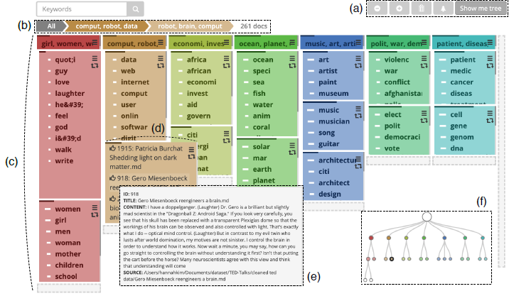
Presentation Overview
Topic modeling
Classifying documents
Examples and current shortfalls
ArchiText:
Hierarchical topic modeling
User interaction
Underlying algorithm
Tight integration and visualization
Using ArchiText and testing

Slide 3
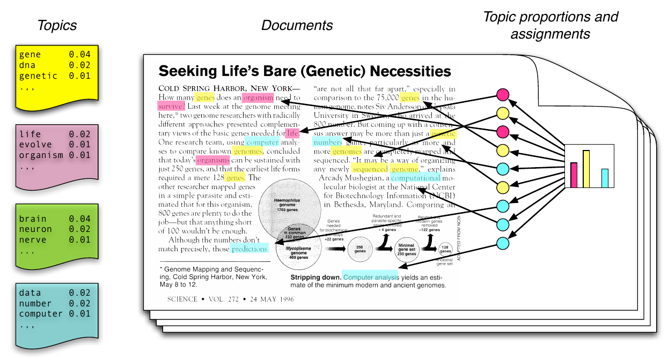
What is Topic Modeling?
Classifying of documents or complex data into “topics” in a statistical model
Unsupervised machine learning
Scan words in each document
Cluster related words (“topics”) to best classify documents
Many purposes
Organize, discover insights on collection of documents
User recommendations, tagging, convenience
Image Source: https://www.slideshare.net/FarheenNilofer/topic-modeling-using-big-data-analytics

Slide 4
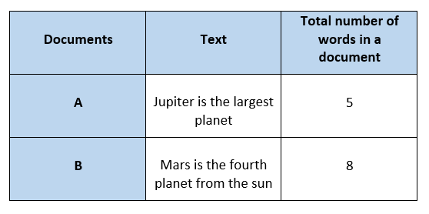
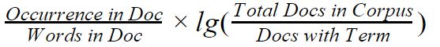
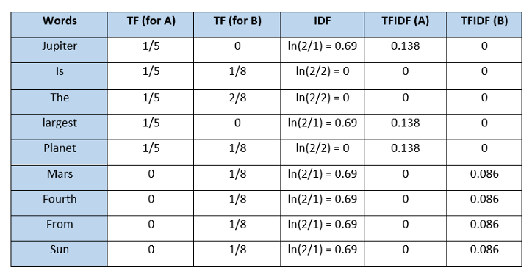
Ranking & Classifying Documents
Difficult to classify text data
Many ranking & classification methods:
TF-IDF: Term Frequency - Inverse Doc Frequency
NMF: Non-negative Matrix Factorization
Core concept behind topic modeling
TF-IDF Source: Dr. Michele Weigle, CS 432/532 (Module 6, Part 3: Searching the Web - Ranking: TF-IDF)
Image Source: https://ichi.pro/id/vektorisasi-teks-term-frequency-inverse-document-frequency-tfidf-99229146339949

Slide 5
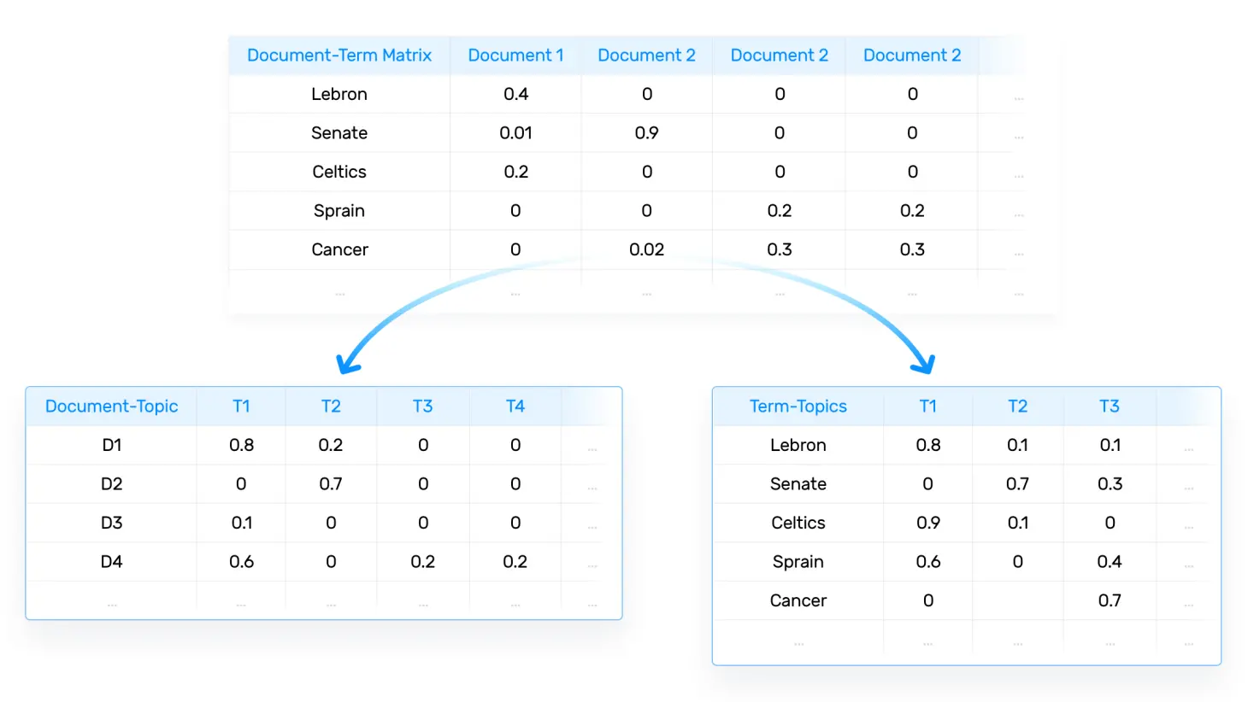
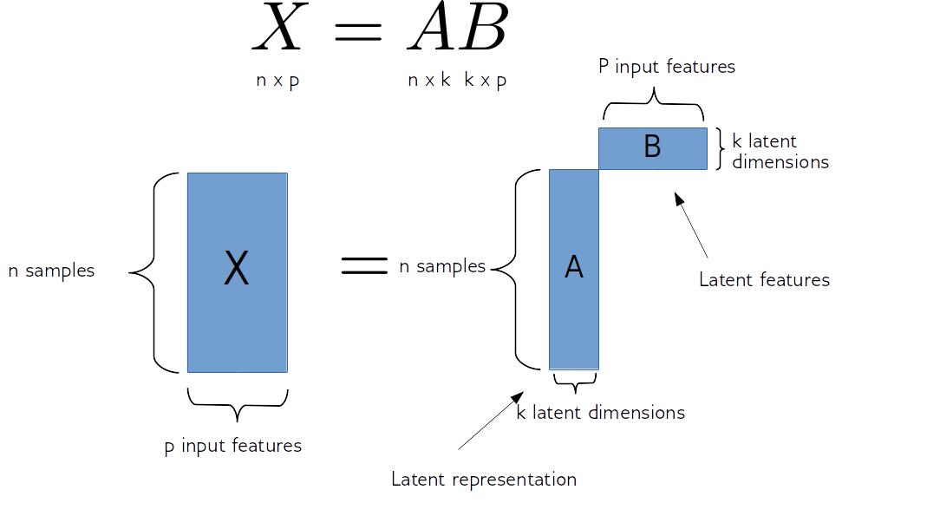

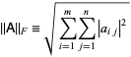
Topic Modeling Methods
LSA - Latent Semantic Analysis: >>>>>
Word-document matrix decomposed
Singular Value Decomposition (SVD)
LDA - Latent Dirichlet Analysis:
Probability distribution over topics
NMF - Non-negative Matrix Factorization: >>>
2 matrices that, multiplied, are closest to original
Ex: 10 terms and 6 documents into 3 topics:
Left: 10 x 3, Right: 3 x 6
Frobenius norm:
Total error:
Image Source: https://monkeylearn.com/blog/introduction-to-topic-modeling/
https://www.slideshare.net/FarheenNilofer/topic-modeling-using-big-data-analytics
Eqns Source: https://mathworld.wolfram.com/FrobeniusNorm.html

Slide 6
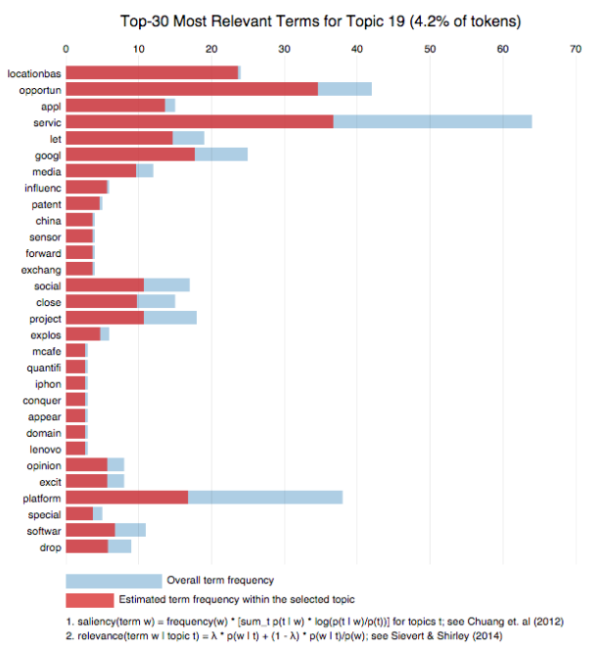
Topic Modeling Shortfalls
Flat models performance is limited
General & coarse-grained topics
Computability, display, visual analyzability
All topics are at the same level
In reality, “World Cup” is a subtopic of “soccer”, which is a subtopic of “sports”
Limited capability to modify/steer
“Black box” topic modeling
Confusing/uninsightful visualization
Unintegrated with algorithm
Image Source: https://begriffs.com/posts/2015-03-10-better-tweets-datascience.html

Slide 7
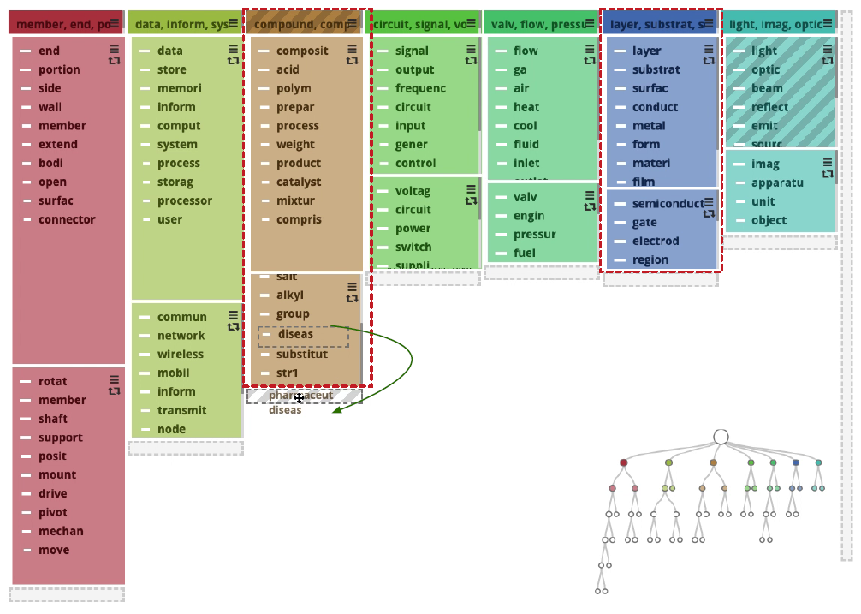
ArchiText: A New Topic Model
A new Visual Analytics System
“HierArchichal interactive topic modeling for large-scale Text data”
Tight integration of vis, interaction, algorithm
Topic, word, or document-level interaction
Correct categorizations, steer model precisely
“Human-in-the-loop” (HITL) modeling
Adjusts scope, amount of user control
Hierarchical topic modeling algorithm
Rank-2 NMF recursively splits topic (HierNMF2)
Nearly 20x faster than LDA*
Better clustering quality and organization
More scalable, adjustable
*Source: https://github.com/dakuang/hiernmf2

Slide 8
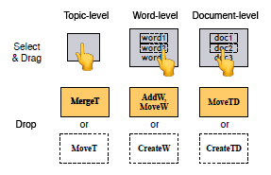
Hierarchical Modeling & Visualization
Topics = most relevant keywords
List of topic documents
Many levels of detail
Model visualization
Interaction-friendly
Click and drag
Control panel of methods
Corresponding topic colors
Integrated with algorithm

Slide 9
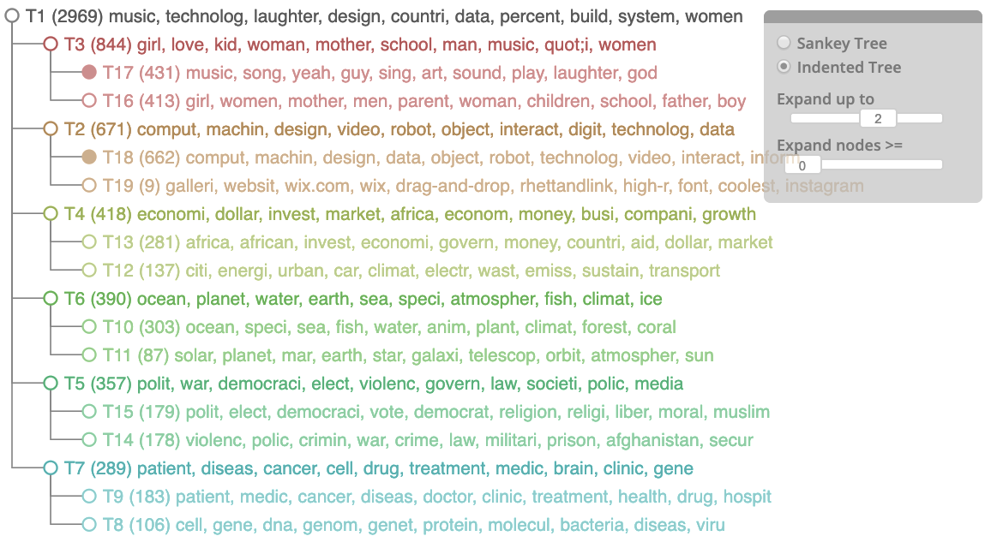
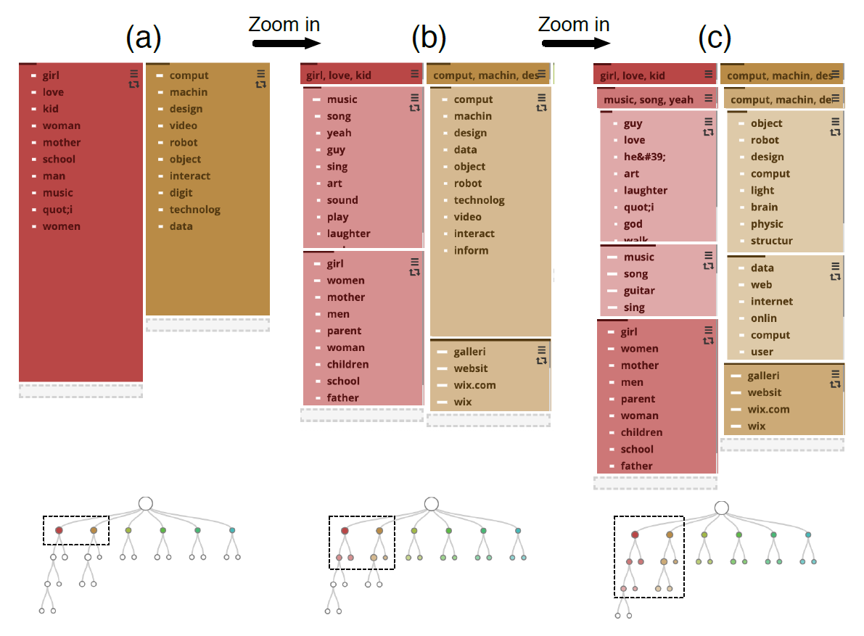
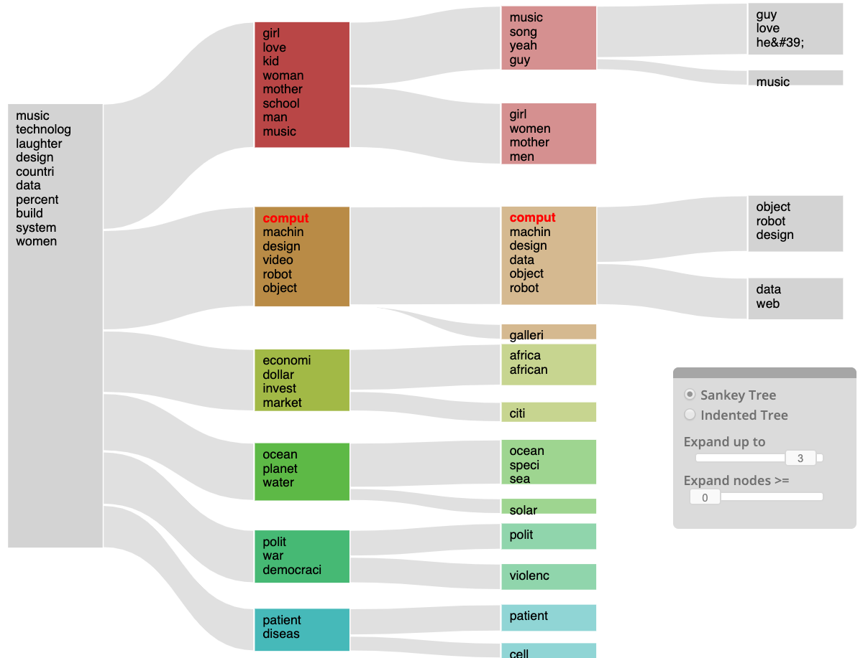
Visualization Options

Slide 10
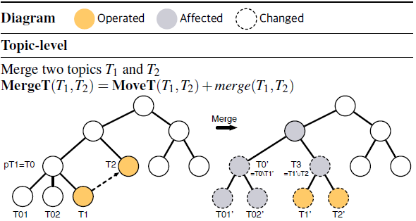
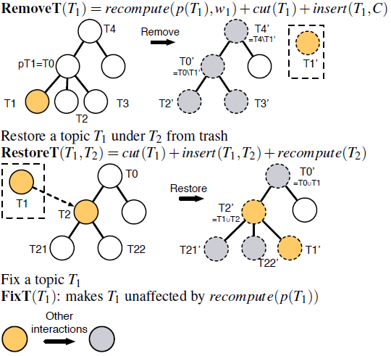
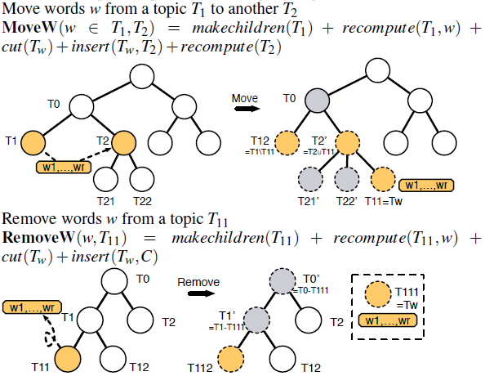
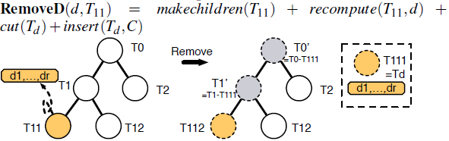
User Interaction
Basic operations (“primitives”)
Interactions on visual objects
Not algorithmic parameters
Interaction Assistant
Tasks for next step
Other items to select
Location to drop selected items
Topic coherence score (Quality)
Pointwise mutual information (PMI)
cut(T₁) merge(T₁, T₂) makechildren(T) | recompute(T) insert(T₁, T₂)

Slide 11

ArchiText’s Algorithm
α & β: amount of user control
Word- & document-level, respectively
Proportionally set to # of interacted topics
M_{W} & M_{H}: masking matrices
(M_{W})_{-r} = 0 & (M_{H})_{r-} = 0 for r ∉ {steered indexes}
(M_{W})_{-r} = 1 & (M_{H})_{r-} = 1 for r ∈ {steered indexes}
W′ & E: target word-topic & topic-doc matrices
Force W & H to be similar to W′ & E, respectively
H is given the help of scaling matrix U
Find W, H, & U resulting in the least error!
NMF

Slide 12
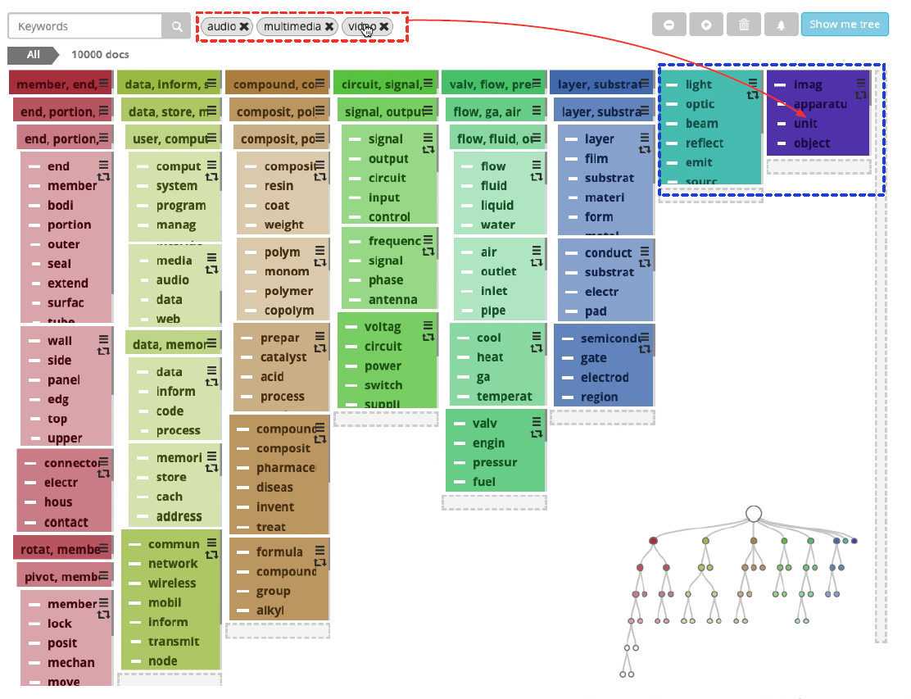
Development & Tight Integration
Programming languages
D3.js visualization library
Flask framework
SQLite database
Algorithm written in MATLABTM
Tight integration
Algorithm, visualization, and user interaction jointly developed
Visualization: makes model and medium for interaction
Interaction: algorithmic and higher-level operations => discovery
Algorithm: performance and interactivity/transparency for vis

Slide 13
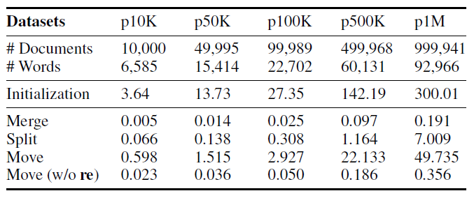
Testing on Large Datasets
Patent dataset:
www.patentsview.org/download
~7 million granted patents + info
10K, 50K, 100K, 500K, and 1M docs
Initialization running time
Topic interaction with ~10% of docs
Results:
Initialize (10 leaves, 1M docs): ~5 min
Most tasks finished in seconds
Recomputations took longer
Changes propagate to descendants
Skipped if insignificant
However, topic quality is unreported
Limit iterations? Recommend smaller interactions (more splits, less altering larger topics)?

Slide 14
Contributions
Tested, well-designed, arguably pioneering prototype
Innovation suited for today’s large datasets
Likely first to achieve tight integration in topic modeling
Rare example of jointly developing algorithm, visualization, interaction
Interaction Assistant conveniently guides
Even rarer example of maintaining scalability, flexibility, performance
Strong case for normalizing use of NMF for topic modeling
Hierarchical model, manipulation fosters new methods of discovery
Fine-grained, better quality topics with more detailed information
Responsive, accurate interpretation of interaction
Accommodates wide range of user tasks and goals

Slide 15
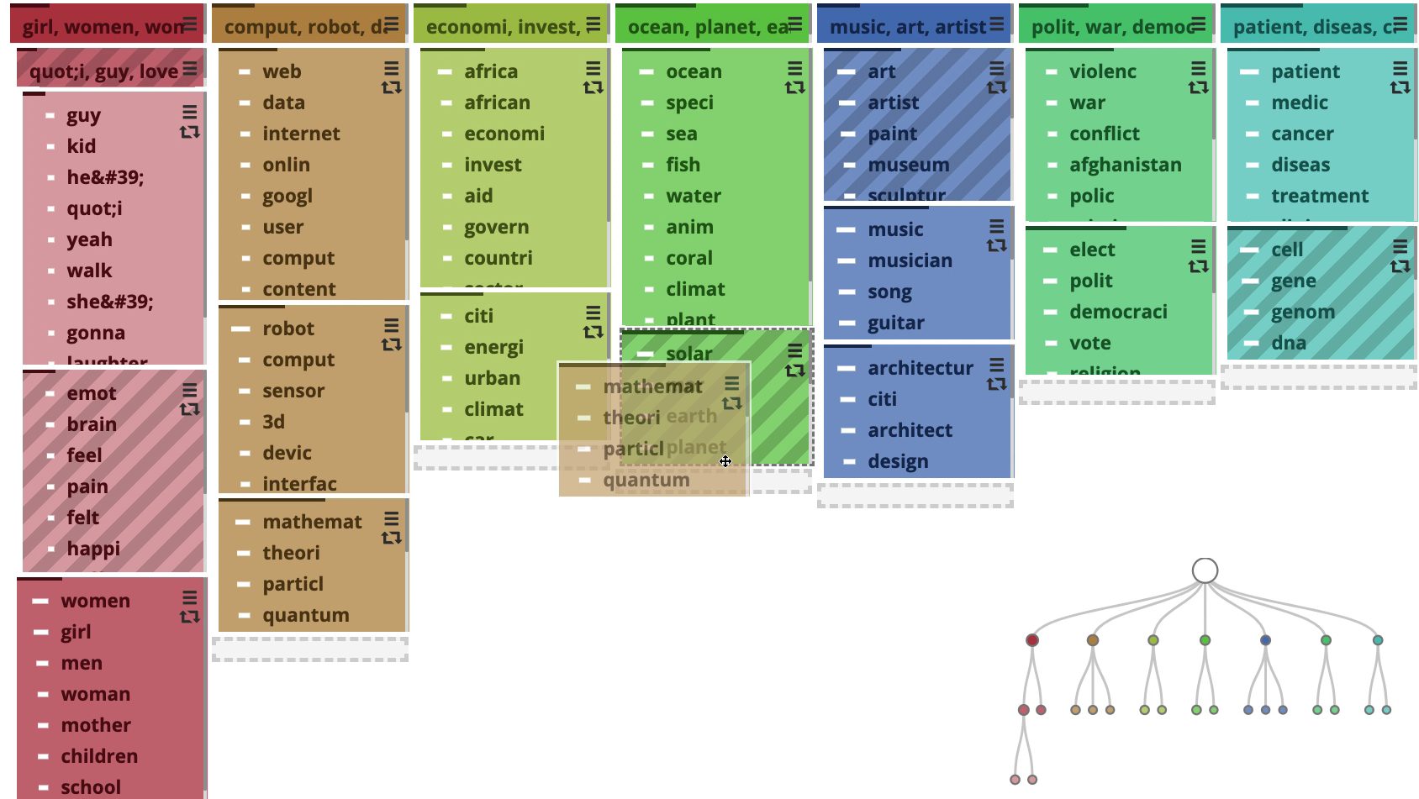
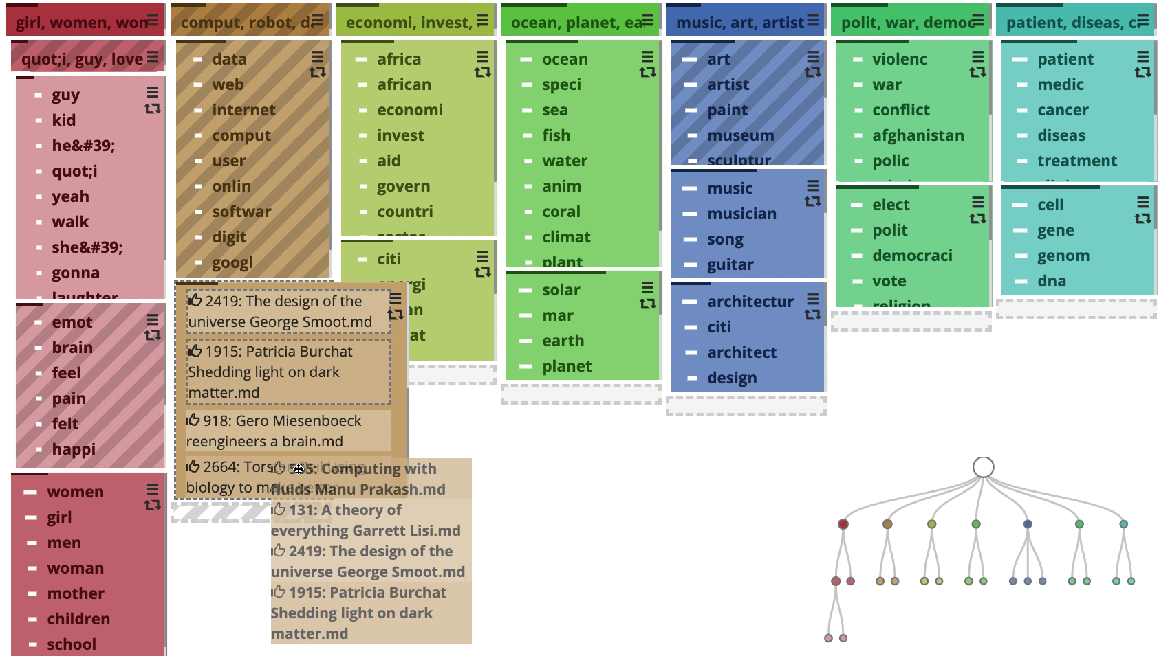
Conclusion
ArchiText: new hierarchical topic modeling implementing tight integration
Fast, interactive, scalable, and broadly applicable, with a quality visualization
Future work: more proactive HITL model, learn from past interactions (ML)
Potential development and my take:
Handle dynamic data? User filtering?
Regex filters? (no links, numbers, etc.)
User input on interactivity, recomputing?
Test against other topic models?
Volunteers to compare topic quality?

